Slide 1
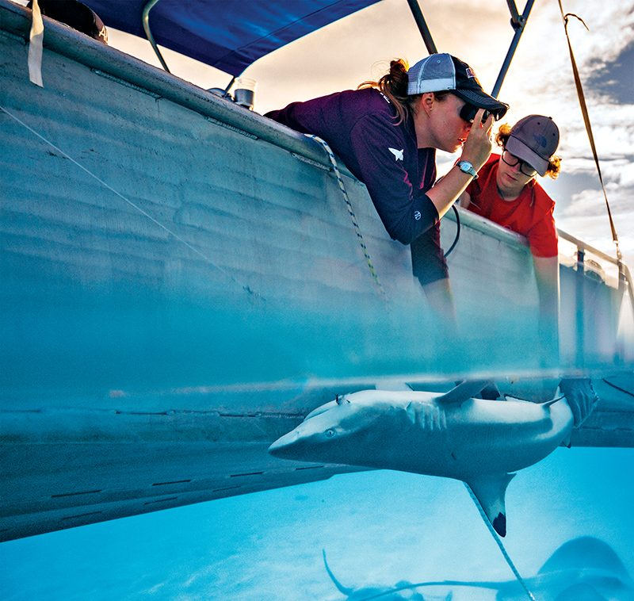

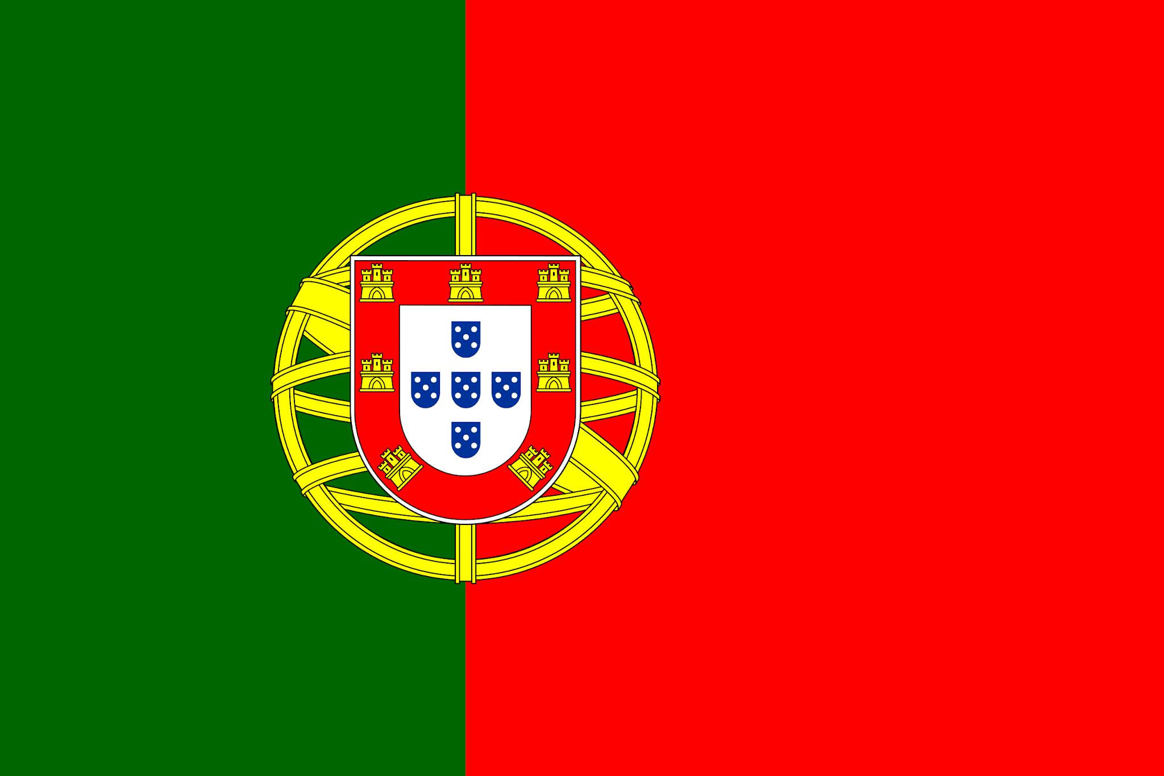
Shark Attack Quest
Ironhack
Manel Ait Amer
Gonçalo Carvalho

Slide 2
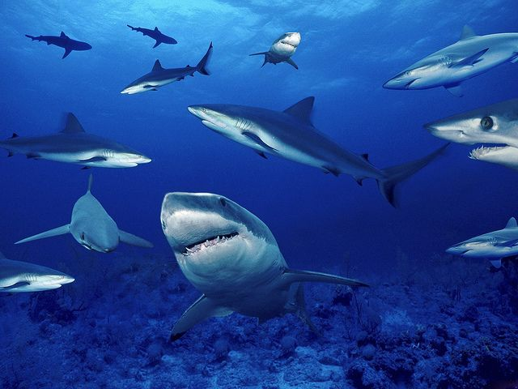
Project Overview - MARILM
MARILM is the word combination of Mar (“Sea” in Portuguese) and Ilm (“Knowledge” in Arabic).
Marilm intends to be an agency that provides shark attacks information to their clients from all over the world.
Marilm is going to answer questions like:
“How many shark attacks happened on a specific country/state?”
“Which shark species attack the most and in where (sea) occurs most of the attacks?”
“What are the injuries of those attacks”?
“Which Seas / Oceans are the most famous for sharks attacks?”
The ultimate goal is that the customer feels safe while enjoy its vacation on the beach.

Slide 3
Methods used:
The methods used in the provided code are aimed at cleaning and analyzing a dataset containing information about shark attacks. Here's a breakdown of the methods used:
Data Cleaning :
Irrelevant columns are dropped from the DataFrame.
Rows with all missing values are removed.
Rows with less than 7 non-null values are removed.
The 'age' column is cleaned and standardized.
The 'injury' column is cleaned and categorized based on severity.
The 'activity' column is cleaned and standardized.
The 'species_' column is cleaned and standardized.
Values in the 'type' column are standardized and categorized.
Data Output :
Plots, tables and functions.
Creating a New Column:
A new column named 'sea' is created based on the countries where the shark attacks occurred.
Aggregating Data:
Data is aggregated using pivot tables to analyze various aspects of shark attacks, such as the type of attack and activity by gender and year.
Questionnaire:
A function is created to provide information about shark attacks in a specified country and state.

Slide 4
Major concerns:
Define the goal of cleaning the data
Amount of data
Define when to stop cleaning the data
Benefits:
Communication and planning tasks
Different solutions and ideas

Slide 5
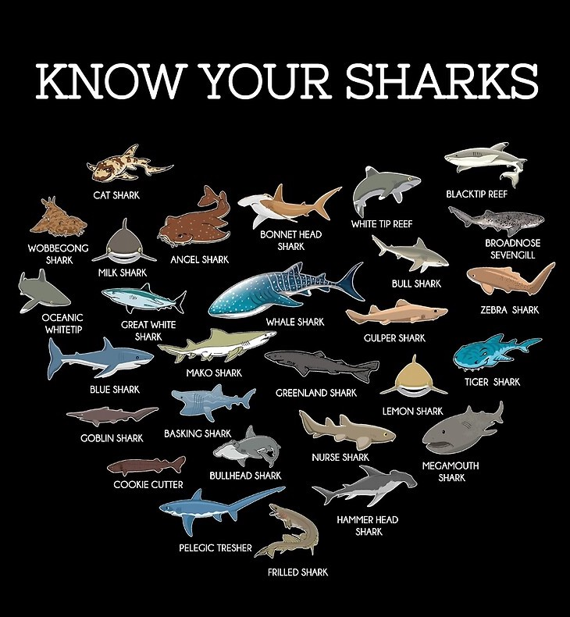
Exploring the World of Sharks
By learning more about these apex predators, we can foster a deeper understanding of their importance and mitigate potential risks, ensuring a harmonious relationship between humans and sharks in our oceans and seas.
The most common species of sharks involved in attacks on humans include the Great Sharks, White Sharks, Tiger Shark, and Bull Shark. These species are known for their size, aggressiveness, and tendency to inhabit coastal areas where human activities are prevalent.
In conclusion, while shark attacks on humans capture headlines and fuel fear, they are exceedingly rare events considering the vast number of people who enter the ocean each year.

Slide 6
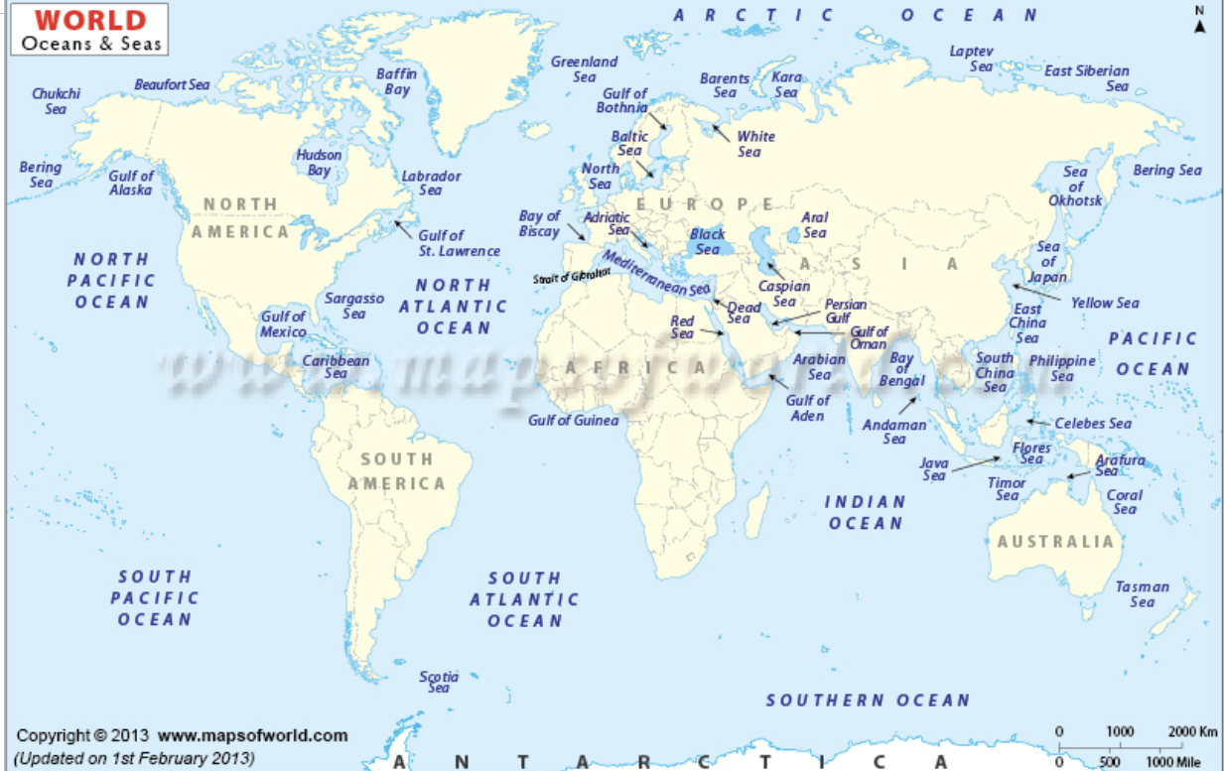
Exploring Seas and Oceans?

Slide 7
Thank you!
If you need some shark attack advice, feel free to reach out!
marilm@sharkattack.com

